Slide 1
GENERATIVE AI PRINCIPLES · MIDTERM PROJECT
MS-ADS
Program Guide
A source-cited conversational assistant
for UChicago’s MS in Applied Data Science
Implementation and evaluation
01
Notes:
MS-ADS Program Guide
Timing: 20 seconds. Total presentation: 10:00.
This project is an unofficial program information assistant for UChicago’s Master’s in Applied Data Science. It answers questions using a saved collection of official pages and provides citations so users can inspect the evidence. I’ll explain the implementation, evaluation results, and remaining limitations.
Sources (project snapshot, November 6, 2026):
/Users/sovinbirla/UChicago/Generative AI/Midterm Project/README.md

Slide 2
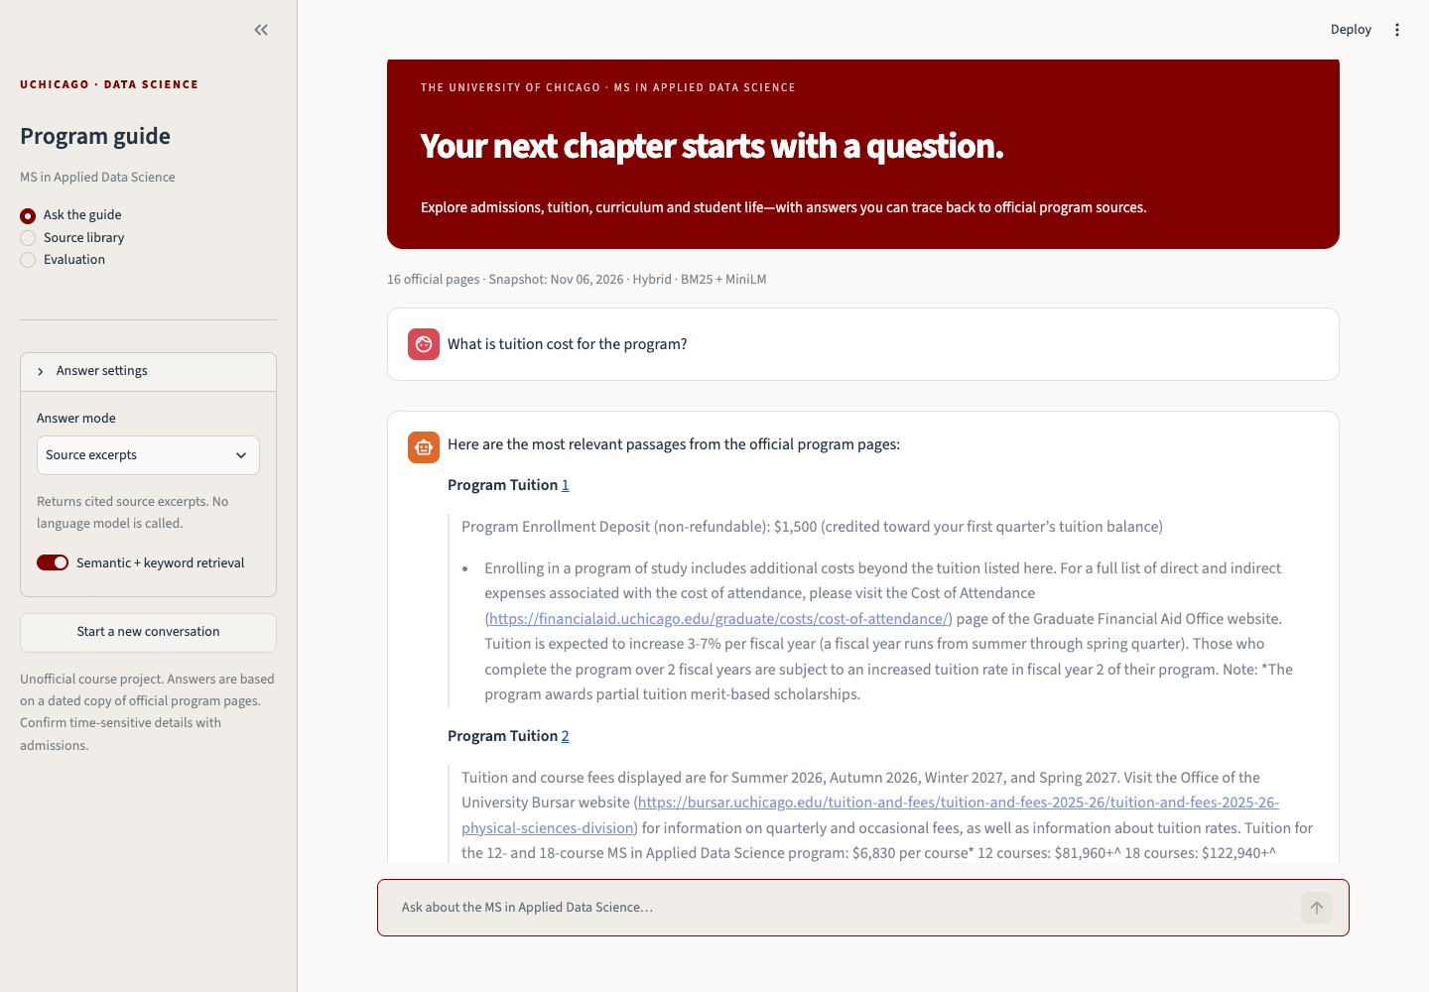
A guide for program questions
Prospective students need
traceable program answers.
What the interface supports
Ask questions and follow-ups
Inspect retrieved passages
Browse the saved source library
Run and export evaluation
Saved interface screenshot. Source-excerpt mode shown.
02
Notes:
Interface and use case
Timing: 40 seconds. Total presentation: 10:00.
The intended user asks about admissions, tuition, curriculum, or program policies without searching across multiple pages. The Streamlit interface offers suggested questions, conversational follow-ups, and expandable retrieved passages. Users can see the actual answer provider, retrieval mode, and latency. The source library exposes the saved pages and collection notices. The evaluation view runs the supplied questions and exports a report. There are three answer modes: source excerpts without a language model, local Ollama generation, and configurable OpenAI generation. Important decisions still require checking the cited official material.
Sources (project snapshot, November 6, 2026):
/Users/sovinbirla/UChicago/Generative AI/Midterm Project/app/streamlit_app.py
/Users/sovinbirla/UChicago/Generative AI/Midterm Project/README.md

Slide 3
Source collection and provenance
16
208
402
official pages
extracted sections
searchable chunks
Bounded official-source crawl
Versioned evidence
Program subtree and selected policy pages
Robots checks, timeouts, crawl limit and delays
URL, heading, content hash and collection date
One page had no extractable body and a visible notice
Corpus snapshot: November 6, 2026. Assignment examples never enter the retrieval index.
03
Notes:
Source collection
Timing: 50 seconds. Total presentation: 10:00.
The knowledge base contains sixteen official pages collected on November sixth, 2026. The crawler begins at the program site and follows only approved program and policy URLs, including relevant English requirements, fees, and the Booth joint degree. It checks robots.txt, limits the crawl, applies timeouts, and records failures. The collection preserves each page’s URL, title, content hash, and snapshot date. One events and deadlines page produced no extractable body, so the app records that notice rather than supplying missing content. Application deadlines remain available from How to Apply. The assignment PDF and sample answers never enter the retrieval corpus.
Sources (project snapshot, November 6, 2026):
/Users/sovinbirla/UChicago/Generative AI/Midterm Project/app/rag/ingest.py
/Users/sovinbirla/UChicago/Generative AI/Midterm Project/app/data/corpus.json
/Users/sovinbirla/UChicago/Generative AI/Midterm Project/README.md

Slide 4
Preprocessing preserves source meaning
Stage | Implementation detail
Clean HTML | Remove navigation, forms, scripts and related-news blocks
Preserve structure | Keep FAQ parent categories, tables, addresses and links
Normalize facts | Repair repeated commas and label existing tuition pairs
Create chunks | 850 characters with 120-character overlap within each section
Each chunk retains its source URL, page title, heading and snapshot date.
Known limit: character budgets can still exceed the embedding model’s 256-token window.
04
Notes:
Preprocessing and chunks
Timing: 50 seconds. Total presentation: 10:00.
Preprocessing removes navigation, scripts, sidebars, forms, and repeated page noise. It retains useful headings, links, addresses, tables, and FAQ answers. Preserving nested FAQ categories matters because a requirement for the joint MBA and MS program can differ from the standalone program. Tuition extraction also converts existing course-count and price pairs into explicit labels. LangChain then splits each section into overlapping chunks, using an eight-hundred-fifty-character budget and one-hundred-twenty-character overlap. The snapshot produces four hundred and two searchable chunks. Each keeps its source metadata and a deterministic identifier. Character limits can still exceed the embedding model’s token limit, which motivates tokenizer-aware splitting.
Sources (project snapshot, November 6, 2026):
/Users/sovinbirla/UChicago/Generative AI/Midterm Project/app/rag/ingest.py
/Users/sovinbirla/UChicago/Generative AI/Midterm Project/app/rag/retrieval.py
/Users/sovinbirla/UChicago/Generative AI/Midterm Project/app/data/corpus.json

Slide 5
System architecture
Offline preparation
Official pages
Cleaned snapshot
and chunks
Cached BM25 index +
Chroma vectors
Question-time flow
Question + limited
conversation
Redact and
check scope
Retrieve six
passages
LLM generation
Excerpt mode
or fallback
Answer + original
source links
Validate generated
citations + tuition pairs
Session chats and keys stay separate
from shared retrieval resources.
05
Notes:
System architecture
Timing: 60 seconds. Total presentation: 10:00.
The system separates preparation from the question-answering path. Offline preparation collects official pages, extracts sections, creates chunks, and builds lexical and semantic indexes. At question time, the app redacts selected personal-information patterns and checks scope. Retrieval uses the question, with limited prior context for a short follow-up. The highest-ranked passages feed either the excerpt baseline or an evidence-grounded language-model prompt. Generated answers pass through citation, link, and tuition-pair checks before display. If generation fails, the system returns labeled source excerpts. Chroma persists embeddings on disk, while Streamlit caches reusable search resources. A fingerprint ties the collection to chunk identifiers and model configuration, so a changed corpus receives a different index. Chat state remains separate from the shared retrieval resources.
Sources (project snapshot, November 6, 2026):
/Users/sovinbirla/UChicago/Generative AI/Midterm Project/app/rag/prepare.py
/Users/sovinbirla/UChicago/Generative AI/Midterm Project/app/rag/retrieval.py
/Users/sovinbirla/UChicago/Generative AI/Midterm Project/app/rag/engine.py
/Users/sovinbirla/UChicago/Generative AI/Midterm Project/app/streamlit_app.py

Slide 6
Model architecture and hybrid retrieval
Component | Model or configuration
Keyword retrieval | BM25, k₁ = 1.5, b = 0.75, admissions vocabulary aliases
Semantic encoder | all-MiniLM-L6-v2, 6 transformer layers, mean pooling
Embedding store | 384-dimensional normalized vectors, Chroma cosine index
Rank fusion | Up to 50 candidates per branch, RRF constant = 60
Fused score = Σ 1 / (60 + rank)
Return the top six passages
Program-aware penalties reduce unrelated MBA/MS and PhD evidence. BM25 remains available if semantic setup fails.
06
Notes:
Models and hybrid retrieval
Timing: 60 seconds. Total presentation: 10:00.
The lexical branch uses BM25, which rewards distinctive matching terms while accounting for repetition and document length. General query expansions connect vocabulary such as cost with tuition, or advising with appointment. The semantic branch uses the pretrained all-MiniLM-L6-v2 sentence transformer locally to produce normalized, three-hundred-eighty-four-dimensional vectors. Chroma searches these vectors with cosine distance. The two branches each consider up to fifty candidates, and reciprocal-rank fusion combines their rankings with a constant of sixty. The default answer context contains six passages. Unrequested joint-degree or doctoral sections receive lower ranking weights. If the semantic model cannot load, the interface clearly shows BM25-only retrieval. This project uses pretrained models and retrieval rather than training a new model on admissions answers.
Sources (project snapshot, November 6, 2026):
/Users/sovinbirla/UChicago/Generative AI/Midterm Project/app/rag/retrieval.py
/Users/sovinbirla/UChicago/Generative AI/Midterm Project/README.md

Slide 7
Grounded generation and fallback
Generation choices
Checks after generation
OpenAI: configurable gpt-4.1-mini
Ollama: installed local models
Source excerpts: no generative model
Citation IDs exist
Factual answer includes citations
Links occur in retrieved evidence
Tuition totals match course-count labels
Evidence-grounded prompt
LangChain separates evidence and instructions.
JSON answers cite source numbers.
Six redacted messages provide context.
Invalid output or a provider failure
returns labeled source excerpts.
Citation validity alone does not establish factual support. Privacy and scope checks use limited heuristics.
07
Notes:
Generation validation and sessions
Timing: 50 seconds. Total presentation: 10:00.
The generation prompt limits answers to retrieved official evidence, asks for source numbers, and distinguishes program formats and years. The model returns structured JSON containing an answer and an insufficient-evidence flag. Validation rejects nonexistent citation identifiers, unsupported links, and particular mismatched tuition totals. These checks reduce specific errors but cannot prove that every sentence follows from its citation. The system sends only the latest six redacted conversation messages, with length limits. Emails, common North American phone numbers, and SSN patterns receive regex redaction. Chat and user-entered keys stay in the current Streamlit session. The app also exposes uncertainty and refers unsupported questions to admissions.
Sources (project snapshot, November 6, 2026):
/Users/sovinbirla/UChicago/Generative AI/Midterm Project/app/rag/engine.py
/Users/sovinbirla/UChicago/Generative AI/Midterm Project/app/streamlit_app.py
/Users/sovinbirla/UChicago/Generative AI/Midterm Project/app/tests/test_rag.py

Slide 8
Evaluation design
Question group | Role in evaluation
12 provided examples | Development set covering tuition, admissions and program facts
3 additional answerable cases | Paraphrases and program-format distinctions
1 scope question | Reported separately from answerable retrieval metrics
Hit@6
MRR@6
Share of answerable questions with a labeled
relevant passage in the first six results.
Average reciprocal rank of the first relevant
passage. A missed passage contributes zero.
Relevance labels require both a matching URL and section heading. References stay outside the corpus.
08
Notes:
Evaluation design and definitions
Timing: 45 seconds. Total presentation: 10:00.
The saved evaluation combines twelve supplied development questions with three additional answerable validation questions and one scope check. Relevant evidence must match both a curated source URL and section heading. Hit at six measures whether at least one labeled relevant passage appears among the first six results. Mean reciprocal rank rewards placing the first relevant passage near the top. The scope question is excluded from answerable retrieval denominators. These are small, development-oriented checks. The saved full evaluation requested retrieval only, so it contains no generated-answer relevance score. Optional reference-term coverage measures lexical overlap and does not establish factual accuracy.
Sources (project snapshot, November 6, 2026):
/Users/sovinbirla/UChicago/Generative AI/Midterm Project/app/rag/evaluation.py
/Users/sovinbirla/UChicago/Generative AI/Midterm Project/app/data/evaluation_set.json
/Users/sovinbirla/UChicago/Generative AI/Midterm Project/app/data/evaluation_report.json

Slide 9
Retrieval finds evidence across the test set
Answerable set | Cases | Hit@6 | MRR@6
Provided questions | 12 | 100% | 0.917
Additional validation | 3 | 100% | 0.583
Combined | 15 | 100% | 0.850
10 of 12
Ranking still weakens on paraphrases
Scholarship paraphrase: first relevant at rank 4
Mean retrieval latency: 66.94 ms across 16 cases
provided questions find relevant
evidence at rank 1
09
Notes:
Retrieval results
Timing: 65 seconds. Total presentation: 10:00.
Hybrid retrieval found labeled relevant evidence in the top six for all twelve supplied questions and all three answerable validation questions. Hit at six is therefore one hundred percent in both groups. Ranking quality reveals a more useful difference. Mean reciprocal rank is point nine one seven on the supplied questions, point five eight three on the three validation questions, and point eight five zero overall. Most supplied questions find relevant evidence at rank one, while scholarships and the MBA and MS application question first match at rank two. The additional merit-funding question first matches at rank four. Mean recorded latency across all sixteen retrieval rows is about zero point zero six seven seconds. This does not include answer generation. The validation gap suggests that finding evidence remains easier than consistently ranking it first.
Sources (project snapshot, November 6, 2026):
/Users/sovinbirla/UChicago/Generative AI/Midterm Project/app/data/evaluation_report.json
/Users/sovinbirla/UChicago/Generative AI/Midterm Project/app/data/evaluation_set.json
/Users/sovinbirla/UChicago/Generative AI/Midterm Project/app/rag/evaluation.py

Slide 10
Response relevance: three saved examples
Assistant review of 3 saved responses
Relevance rubric: 0 = off-topic, 1 = partial, 2 = directly answers the question.
All three responses address the requested information.
Saved Ollama answer | Relevance | Observed latency
Tuition and pathway totals | 2 / 2 | 68.75 seconds
Online visa sponsorship | 2 / 2 | 29.20 seconds
English score requirements | 2 / 2 | 26.27 seconds
BM25 context. This subset review does not establish full-set correctness or citation support.
The full retrieval run did not generate answers. Human scoring and OpenAI testing remain future work.
10
Notes:
Response relevance evidence
Timing: 55 seconds. Total presentation: 10:00.
Response evidence is narrower than retrieval evidence. An assistant review scored three saved Ollama answers using a relevance rubric: zero for off-topic, one for partial, and two for directly answering the requested information. All three score two out of two. Tuition preserves the per-course amount and both pathway totals. The visa answer directly says no, and the English answer distinguishes both tests and prior versus current requirements. These checks used BM25-only context. Their observed latencies were sixty-eight point seven five, twenty-nine point two zero, and twenty-six point two seven seconds. This small review does not establish full-set correctness or citation support. The full retrieval run generated no answers. Human rubric scoring and OpenAI generation testing remain future work.
Sources (project snapshot, November 6, 2026):
/Users/sovinbirla/UChicago/Generative AI/Midterm Project/app/data/ollama_smoke_report.json
/Users/sovinbirla/UChicago/Generative AI/Midterm Project/README.md

Slide 11
Challenges shaped the implementation
Observed challenge | Implemented response
Standalone and joint-degree FAQ facts mix | Preserve FAQ parents and de-prioritize unrelated programs
Source details change across cycles | Store snapshot dates and distinguish current/prior policies
Local model swapped tuition totals | Validate course-count and amount pairs before display
Local serving can be slow or unavailable | Cache retrieval resources and fall back to source excerpts
Retrieval can find the right numbers while generation assigns them to the wrong pathway.
11
Notes:
Challenges encountered
Timing: 55 seconds. Total presentation: 10:00.
Several challenges shaped the implementation. The website mixes programs and historical requirements, so headings and program distinctions must survive extraction and retrieval. Numeric formatting also matters: a local-model test swapped tuition totals between pathways, which led to the explicit pair validator. Some official pages contain little extractable text, making collection notices necessary. Local generation is much slower than retrieval, and semantic dependencies may be unavailable on a fresh host. Persistent indexes, visible operating modes, and source-excerpt fallback address availability. Finally, valid citation numbers can accompany unsupported claims. The present checks provide useful safeguards, while manual review remains necessary for response quality and sensitive admissions details.
Sources (project snapshot, November 6, 2026):
/Users/sovinbirla/UChicago/Generative AI/Midterm Project/README.md
/Users/sovinbirla/UChicago/Generative AI/Midterm Project/app/rag/ingest.py
/Users/sovinbirla/UChicago/Generative AI/Midterm Project/app/rag/engine.py
/Users/sovinbirla/UChicago/Generative AI/Midterm Project/app/tests/test_rag.py

Slide 12
Future improvements
1
Measure answer quality
Generate the full set and collect human rubric scores.
2
Improve evidence ranking
Test held-out paraphrases, BM25 versus hybrid and a reranker.
3
Strengthen evidence handling
Use tokenizer-aware chunks and program/year metadata.
4
Prepare for staff evaluation
Refresh sources, benchmark serving and validate a hosted URL.
Working local RAG assistant with strong small-set retrieval.
The next milestone is broader answer evaluation.
12
Notes:
Future improvements
Timing: 50 seconds. Total presentation: 10:00.
The next priority is a larger evaluation with independently written, held-out questions and reviewer scores for generated responses. Retrieval improvements include tokenizer-aware chunks, explicit program and year metadata, and reranking experiments against a BM25 baseline. A scheduled source-refresh process should flag changed policies and require reference-label review before comparing results. Structured tuition facts and claim-level support checks could strengthen numeric reliability. Deployment also needs a hosted generation provider and verification of the public interface. The current project demonstrates a traceable RAG pipeline and strong evidence retrieval on this small snapshot, with clear opportunities to improve ranking and establish broader response quality.
Sources (project snapshot, November 6, 2026):
/Users/sovinbirla/UChicago/Generative AI/Midterm Project/README.md
/Users/sovinbirla/UChicago/Generative AI/Midterm Project/app/rag/retrieval.py
/Users/sovinbirla/UChicago/Generative AI/Midterm Project/app/rag/engine.py
/Users/sovinbirla/UChicago/Generative AI/Midterm Project/app/rag/evaluation.py

